Slide 1


Statistic
Lecture 7
Dr. Nada Abdullah Rasheed
Assist prof. / Computer Science

Slide 2
Syllabus Content
Subject | Lec. No.
Pearson Correlation in SPSS | 3
Regression | 7
The Regression Equation | 9

Slide 3
5.5 Pearson Correlation in SPSS
The following uses the GRE Therapy Data file. This data file is based on a hypothetical study examining the influences of a study-aid drug and types of tutoring on performance on the Graduate Record Examinations (GREs). To have SPSS perform correlations, from the Analyze menu, select Correlate, and then select Bivariate:

Slide 4
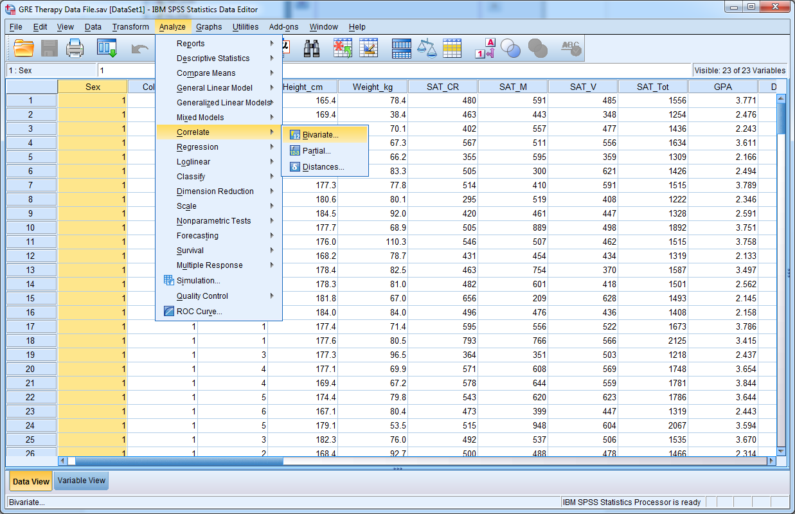
5.5 Pearson Correlation in SPSS

Slide 5
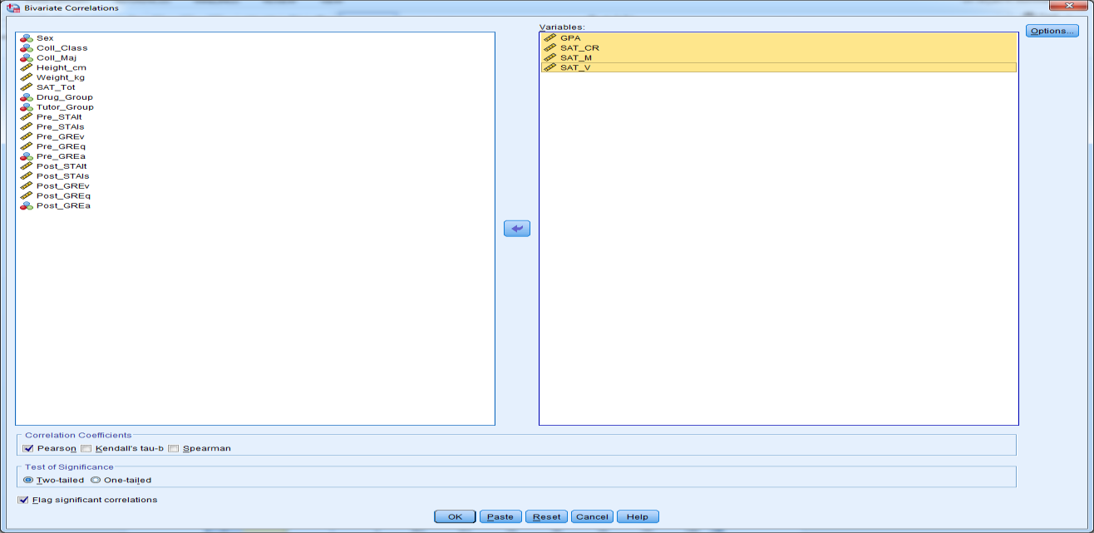
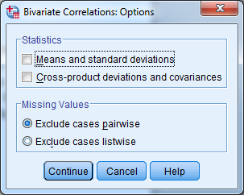

Slide 6
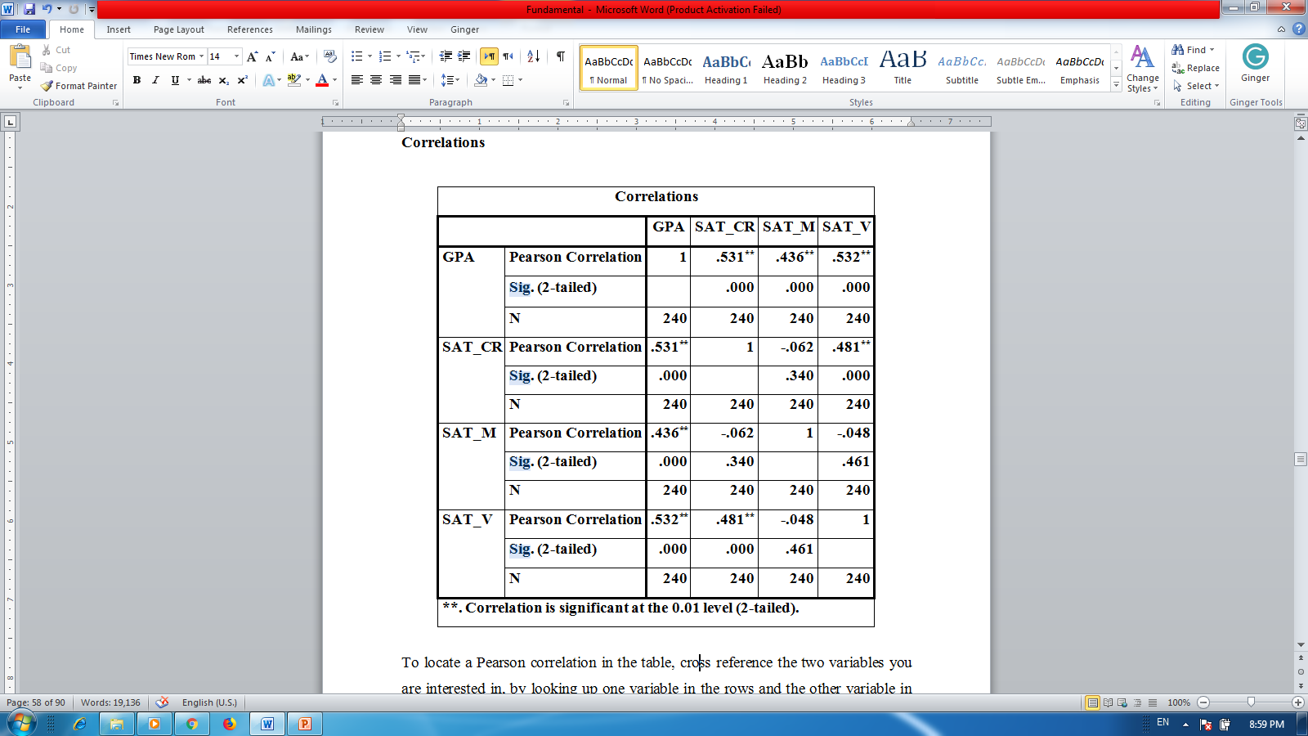
Correlations

Slide 7
Regression
Once a correlation between variables has been established, it would be nice to find a way to predict values of one variable for giving a value of another.
For example, consider the data below. You should see that for every increase in X by 1 there is a corresponding increase in Y by 2, suggesting a positive linear relationship. Say we have a value of X = 8, which does not appear in the table. What value of Y would you predict is equal to X = 8? If the relationship between X and Y stays the same and every increase in X by 1 is associated with an increase in Y by 2, you should predict when X = 8 that Y = 22.

Slide 8
Regression
If the relationship does not change, when X = 9 then Y = 24. How about when we know that Y = 8, what should X be equal to? Because we know the relationship between X and Y is positive and linear and for every change in Y by 2 there is a change in X by 1, when Y = 8 then X = 1.

Slide 9
Regression
X | 2 | 3 | 4 | 5 | 6 | 7
Y | 10 | 12 | 14 | 16 | 18 | 20
Regression deals with linear regression, which is used to model the linear relationship between two variables, so values of one variable can be predicted from another variable.

